Slide 1
ESQC 2024
Mathematical Methods Lecture 1
By Simen Kvaal

Slide 2

Where to find the material
SCAN ME
Alternative 1:
www.esqc.org, go to“lectures”
Find links there
Alternative 2:
Scan QR code
simenkva.github.io/esqc_material

Slide 3
About these lectures
What to expect

Slide 4
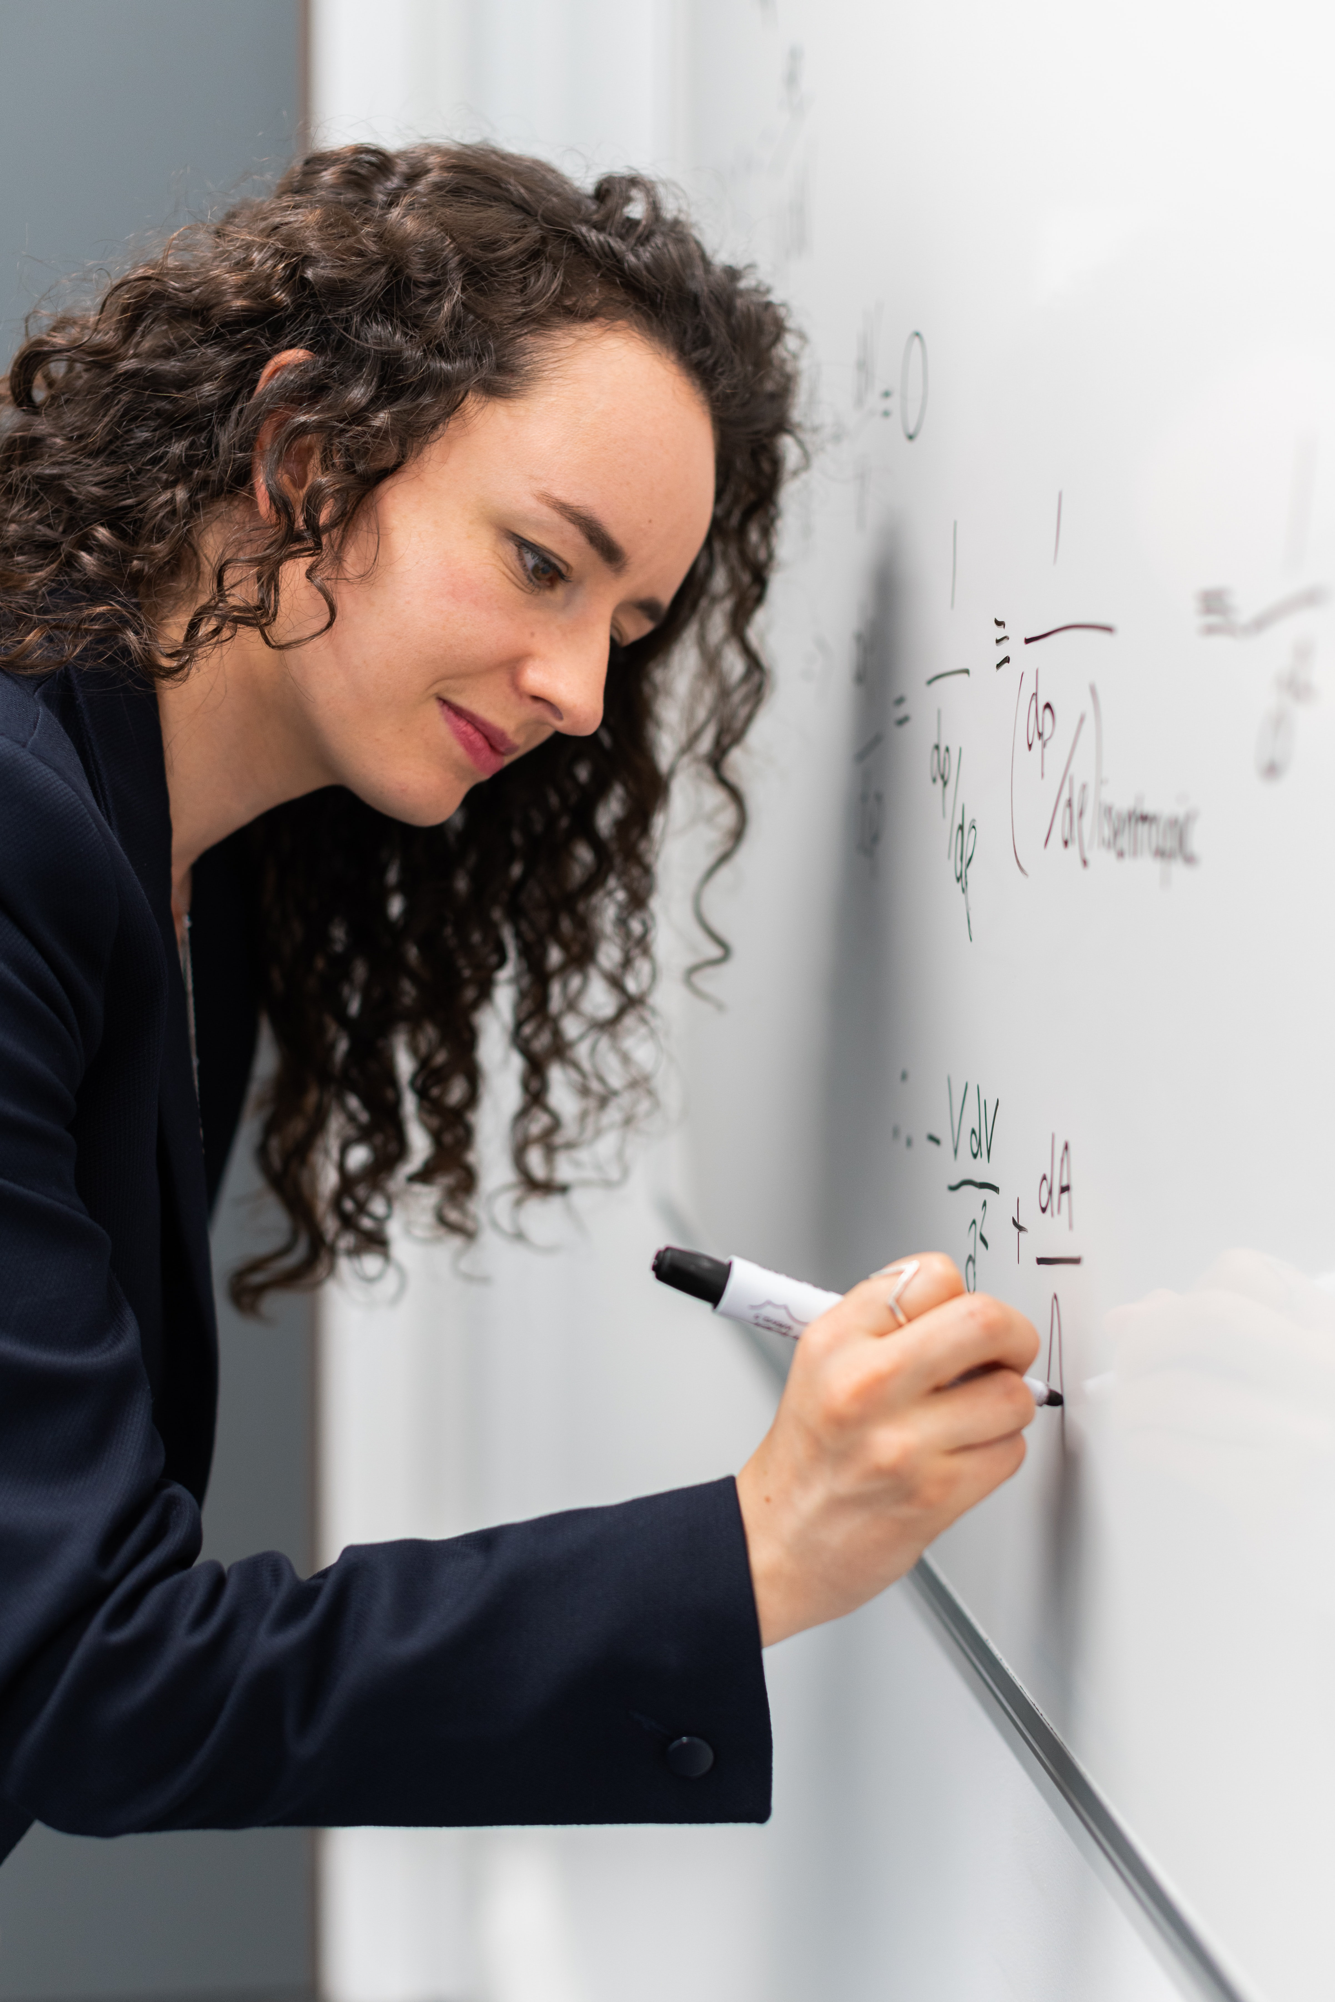
Why learn mathematics?
Quantum chemistry requires mathematics
From applications of DFT …
… to invention of new methods
Mathematics is fun and useful

Slide 5
Mathematics, you see, is not a spectator sport. To understand mathematics means to be able to do mathematics.
(From “How To Solve It”)
George Pólya (1887–1985)
Hungarian-American mathematician

Slide 6
Idea behind lectures
One cannot teach mathematics in 5 hours
Overview
Inspiration
One cannot learn mathematics in 5 hours
Needs practice
Get a feeling for concepts
Learn where to look
Exercises:
The math exercises are today!
Use the lecture notes when needed

Slide 7
What is mathematics?

Slide 8
Quote from Wikipedia
Mathematics (from Ancient Greek μαθημα; máthēma: ‘knowledge, study, learning’) is an area of knowledge that includes such topics as numbers (arithmetic and number theory), formulas and related structures (algebra), shapes and the spaces in which they are contained (geometry), and quantities and their changes (calculus and analysis). Most mathematical activity involves the use of pure reason to discover or prove the properties of abstract objects, which consist of either abstractions from nature or—in modern mathematics—entities that are stipulated with certain properties, called axioms. A mathematical proof consists of a succession of applications of some deductive rules to already known results, including previously proved theorems, axioms and (in case of abstraction from nature) some basic properties that are considered as true starting points of the theory under consideration.
https://en.wikipedia.org/w/index.php?title=Mathematics

Slide 9
The language of science
Models to describe physical phenomena
Mathematics is the language of these models
Example: The postulates of quantum mechanics
Isn’t it strange, that mathematics can accurately describe nature?

Slide 10

A mathematical roadmap
How are mathematical topics connected?
Which topics are useful for quantum chemists?
Feedback welcome!

Slide 11
A look at the roadmap
We look at the web browser
https://simenkva.github.io/esqc_material

Slide 12
At the core: Logic and set theory
All of mathematics can be built using sets

Slide 13

Naïve set theory
In our lectures, like in most mathematics, we will use naïve set theory
Sets are specified as:
List of elements
Conditions on other sets
Words, descriptions, but be careful! “cat” is slang for jazz musicians Russell’s paradox (next slide)
Notes:
C = \{ \text{Romeo}, \text{Pallina}, \text{Micio}, \text{Luna} \} \subset \{ \text{italian cats} \} \subset \{ \text{all cats} \}

Slide 14
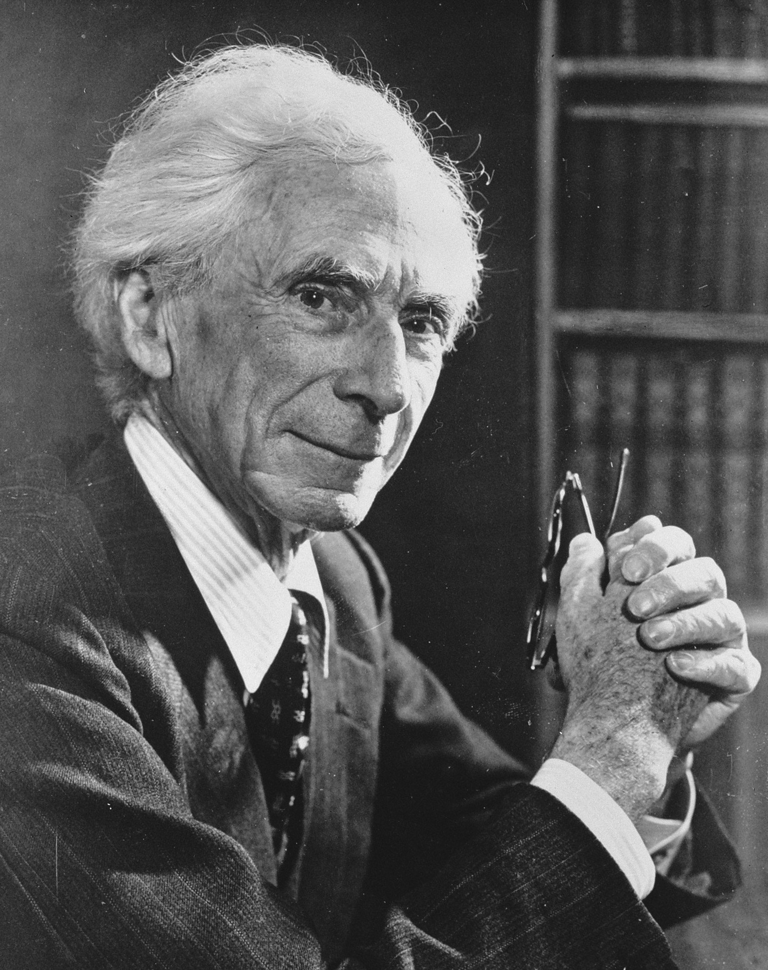
Russell’s paradox (1902)
In a town, there is a hairdresser who cuts the hair of everyone who does not cut their own hair.
Does the hairdresser cut their own hair?
Bertrand Russell in 1957 (from Wikipedia)

Slide 15
More set operations
Union of two sets:
Intersection of two sets:
Set difference/relative complement:
Cartesian product:
Notes:
A \cup B = \{ x \mid x \in A \text{ or } x \in B \}
A \cap B = \{ x \mid x \in A \text{ and } x \in B \}
A \setminus B = \{ x \in A \mid x \notin B \} = B^\complement

Slide 16
Functions
Given two sets S (domain) and T (codomain)
A function f : S → T is a rule, that to every s ∈ S assigns a unique t ∈ T, written t = f(s)
Domain: Possible input
Codomain: Possible output
Range: Set of actual outputs
Surjective/onto: all of T is reached
Injective/one-to-one: Only one s maps to a given t
Bijective: Surjective and injective

Slide 17
Zermelo-Fraenkel set theory with axiom of choice (ZFC)
Consistent and powerful foundation for mathematics
Almost all of mathematics can be built with ZFC
Some people take unconventional stances, hence ”almost all”
Example: von Neumann’s construction of natural numbers:

Slide 18
Number systems
Foundation for large areas of mathematics

Slide 19

Natural numbers
Notes:
\mathbb{N} = \{0, 1, 2, 3, \ldots \}

Slide 20
Integers
First occurs in Chinese mathematics <300 AD (Han Period or before)
Called “absurd numbers” in Europe until 16th century!
In Europe, first satisfactory account by Cardano (1545)
Notes:
\mathbb{C} = \{ \; x + \mathrm{i} b \;\mid\; a,\, b \in \mathbb{R}\; \}, \qquad \mathrm{i}^2 = -1

Slide 21
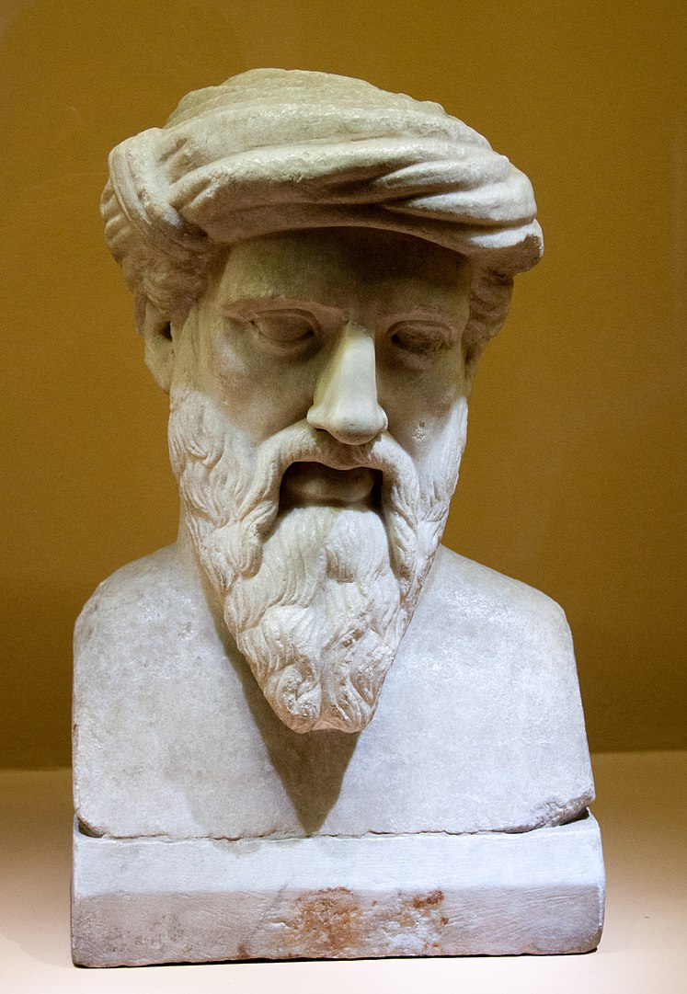
Rational numbers
Pythagoras of Samos
To the Pythagorean school, ”everything is number”. And by number, they meant rational number.

Slide 22
Real numbers
The real numbers form a complete ordered field:
Field: Closed under addition and multiplication, and
every number except 0 has a multiplicative inverse
Ordered: We always have a ⩽ b or b ⩽ a
Completeness: Every Cauchy sequence converges to a number in ℝ
There are much more real numbers than natural numbers

Slide 23
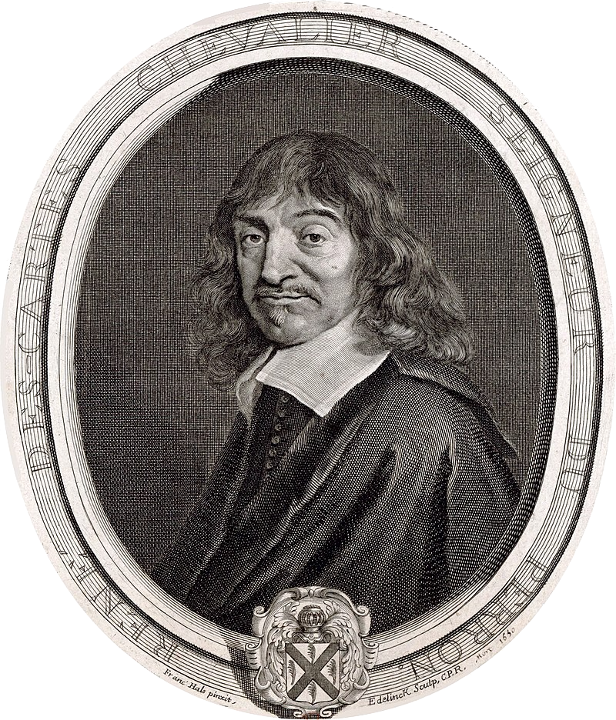
Complex numbers
These numbers have no use, they are imaginary
An algebraic extension of reals
For z = x + i y :
René Descartes (1596–1650)
Notes:
\mathbb{C} = \{ \; x + \mathrm{i} b \;\mid\; a,\, b \in \mathbb{R}\; \}, \qquad \mathrm{i}^2 = -1

Slide 24
Geometric interpretation
Discovered by the Norwegian mathematician and cartographer Caspar Wessel (1797)
Multiplication rule:

Slide 25
Fundamental theorem of algebra

Slide 26
Euclidean space
The foundation of physics

Slide 27
Tuples of real or complex numbers
Time evolution,
magnetic fields
require complex numbers!
All the variables of a quantum chemical method
Notes:
%(x,y) \in \mathbb{R}^2 , \quad x, y \in \mathbb{R}
%(x,y,z) \in \mathbb{R}^3 , \quad x, y, z \in \mathbb{R}
%(x_1,x_2,\cdots,x_n) \in \mathbb{R}^n
(z_1,z_2,\cdots,z_n) \in \mathbb{C}^n
\mathbf{x} = \begin{bmatrix} x_1 \\ x_2 \\ x_3 \\ \vdots \\ x_n \end{bmatrix}

Slide 28
The Schrödinger equation
Matrix eigenvalue equation
Bra-ket notation
Time-dependent Schrödinger eq.

Slide 29
Vectors
By elementwise addition and scalar multiplication, we obtain a vector space
By introducing an inner product we obtain an inner product space – Euclidean space

Slide 32
Example: inner product with std basis
Notes:
\begin{gather*}
\mathbf{x} = \begin{bmatrix} x_1 \\ x_2 \\ x_3 \end{bmatrix} \qquad
\mathbf{e}_2 = \begin{bmatrix} 0 \\ 1 \\ 0 \end{bmatrix} \\
\braket{\mathbf{e}_2, \mathbf{x}} = \mathbf{e}_2 \cdot \mathbf{x} = 0 \cdot x_1 + 1 \cdot x_2 + 0 \cdot x_3 = x_2
\end{gather*}

Slide 33
Example: Norm of vector
Notes:
\begin{gather*}
\mathbf{x} = \begin{bmatrix} x_1 \\ x_2 \\ x_3 \end{bmatrix} \qquad
\|\mathbf{x}\|^2 = \mathbf{x}\cdot\mathbf{x} = x_1^2 + x_2^2 + x_3^2
\end{gather*}

Slide 34
Example: scalar multiplication and addition
Notes:
\mathbf{x} = \begin{bmatrix} x_1 \\ x_2 \end{bmatrix}, \qquad \alpha\mathbf{x} = \begin{bmatrix} \alpha x_1 \\ \alpha x_2 \end{bmatrix}
\mathbf{x} = \begin{bmatrix} x_1 \\ x_2 \end{bmatrix}, \qquad \mathbf{y} = \begin{bmatrix} y_1 \\ y_2 \end{bmatrix}

Slide 35
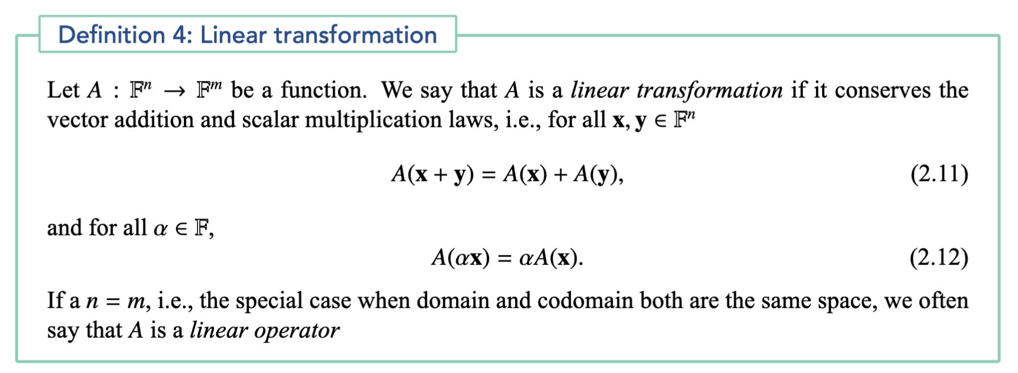
Linear transformation

Slide 36

Examples
Rotations
Reflections
Scaling along some axis
Any combination of linear operations!

Slide 37
Linear transformations and matrices
A linear transformation is determined by a matrix and vice versa
Notes:
A(\mathbf{x})_i = \sum_{j=1}^n A_{ij} x_j
A = \begin{bmatrix} A_{11} & A_{12} & \cdots & A_{1n} \\
A_{21} & A_{22} & \cdots & A_{2n} \\
\vdots & \vdots & \ddots & \vdots \\
A_{m1} & A_{m2} & \cdots & A_{mn} \end{bmatrix}

Slide 38
End of lecture 1
That’s it for today!

